Slide 1
Chapter 6. Natural and Step Responses of RLC Circuits (2)

Slide 2
Contents
The Step Response of a Parallel RLC Circuit
The Nature and Step Response of a Series RLC Circuit

Slide 3
Goals
By this lecture, you should be able to:
  Determine the step response of parallel RLC circuits
  Determine the nature and step response of series RLC circuits

Slide 4
Contents
The Step Response of a Parallel RLC Circuit
The Nature and Step Response of a Series RLC Circuit

Slide 5
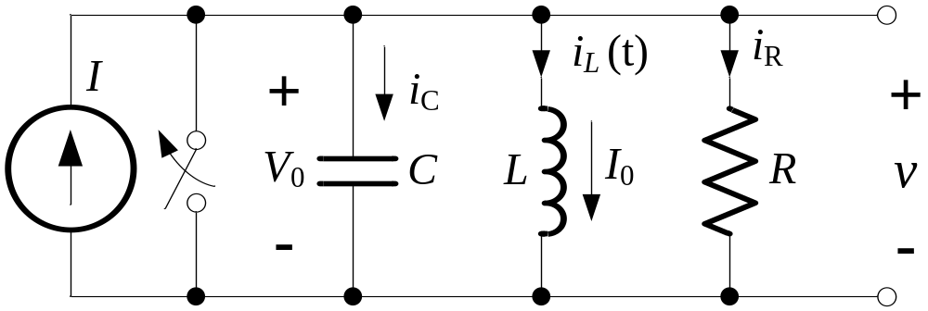
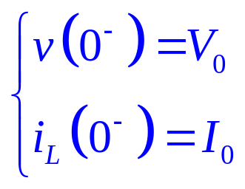
Step Response of Parallel RLC Circuits
A
At t = 0, the switch is opened, and the current source is applied to the circuit.

Slide 6
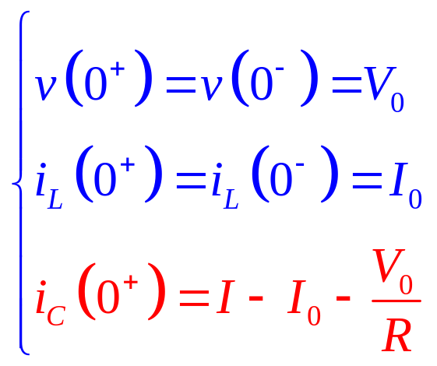
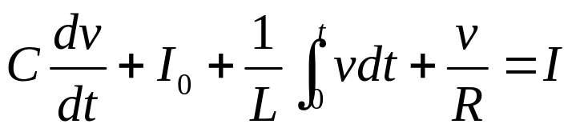
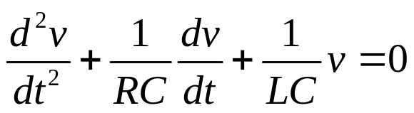
Build Equation by Capacitive Voltage
A
Using KCL for node A:

Slide 7

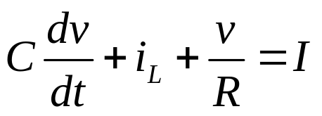
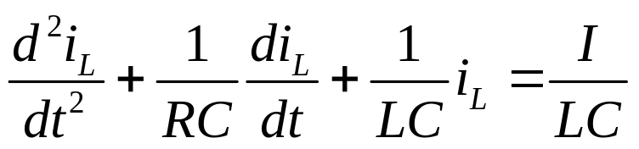
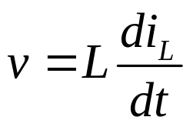
Build Equation by Inductive Current
A
Using KCL for node A:
P226

Slide 8
Series RLC Circuits
Natural Response of Series RLC Circuits
Step Response of Series RLC Circuits

Slide 9
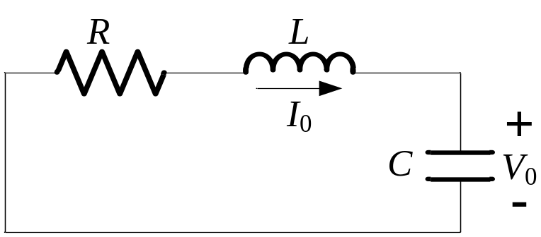
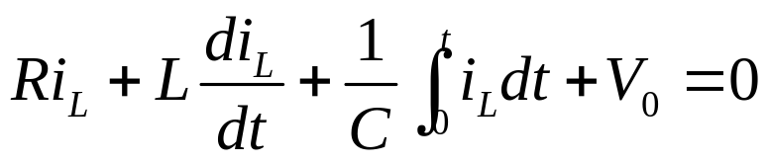

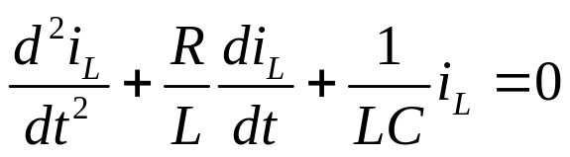
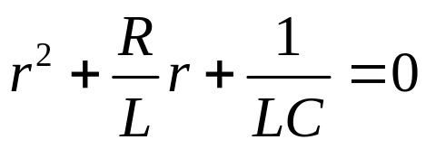
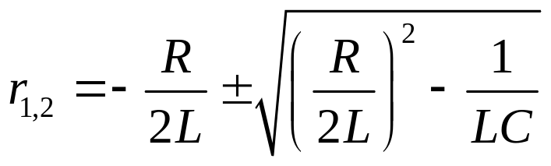
Natural Response of Series RLC Circuits
Apply KVL for the loop:
Characteristic equation:
: Characteristic Roots

Slide 10
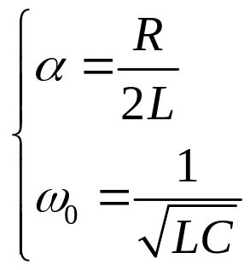
Natural Response of Series RLC Circuits
:Complex Frequency
: Neper Frequency
: Resonant Radian Frequency

Slide 11
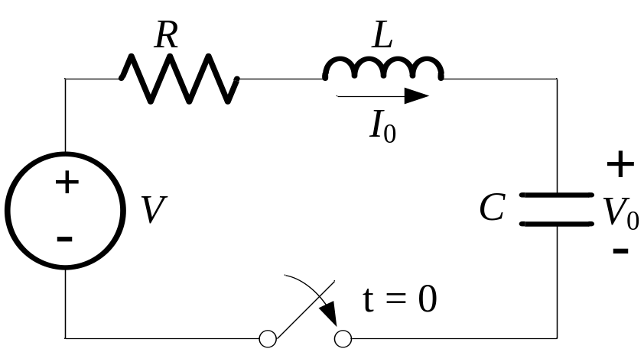
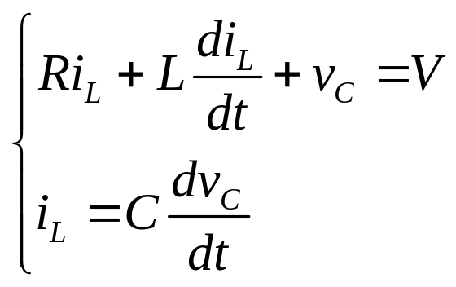
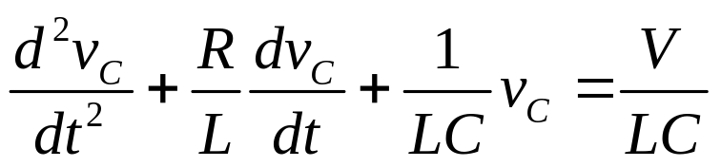
Step Response of Series RLC Circuits
Apply KVL for the loop:

